Slide 1

23AID304 – High Performance and Cloud Computing Review 1
Learning-Based Model Predictive Control for Multi-Room Energy Incident Management in
Smart Hospitals Using Cloud Services
Team 9 :
Gowtham SD : CB.AI.U4AID23113
Guhan K B : CB.AI.U4AID23114
Vaishnavi Gupta : CB.AI.U4AID23149
Vyshnav Kumar S : CB.AI.U4AID23151

Slide 2
Contents
Introduction
Problem statement
Objective
Methodology
Progress
References

Slide 3
Introduction
Hospitals require reliable energy and thermal management to maintain patient safety and comfort.
Traditional systems lack adaptability, prioritization, and cloud-based remote access.
This project uses Learning-Based Model Predictive Control (LB-MPC) to manage HVAC across multiple hospital zones.
Real-time data is sent to the cloud for monitoring, visualization, and remote updates, ensuring intelligent and scalable control.

Slide 4
Problem statement
Existing hospital EMS systems are limited by hardware dependency and lack priority-based energy allocation across critical zones.
Conventional MPC approaches rely on static or data-hungry models, reducing accuracy under dynamic conditions.
Current systems lack scalability and cloud-based intelligence needed for real-time, adaptive multi-room energy management.

Slide 5
Objective
Simulate real-time hospital energy demand across zones with different priorities.
Optimizes energy dispatch considering battery state-of-charge and grid limits.
Provides an interactive, dashboard for remote control and monitoring.
Operates fully in the cloud without hardware dependencies.

Slide 6
Methodology
1. Thermal and Electrical Modeling of Hospital Zones (DONE)
Develop RC thermal models for individual hospital rooms.
Simulate temperature variations and HVAC-driven energy usage.
Incorporate electrical load profiles for each room based on lighting, equipment, and occupancy.
2. Power Grid and EMS Simulation (DONE)
Model a power grid supplying energy to hospital zones and HVAC systems.
Integrate an EMS block to monitor and manage room-level energy consumption.

Slide 7
Methodology
3. Data Acquisition Layer (DONE)
Collect real-time data from sensors across hospital zones (temperature, power usage).
Gather grid status, load profiles, and HVAC system activity.
Send data to both the cloud and EMS block for control and analysis.
4. Forecasting Module
Predict ambient temperature and power availability using time-series models.
Feed predictions into the cloud to assist LB-MPC in disturbance-aware control.
Enable proactive decision-making under uncertain conditions.

Slide 8
Methodology
5. Cloud Integration
Act as a central hub for data storage, forecast distribution, and control coordination.
Log real-time system states and performance metrics.
Interface with the forecasting module and deliver inputs to the LB-MPC.
6. Learning-Based MPC (LB-MPC) Control
Optimize HVAC and energy control actions using forecast and real-time inputs.
Maintain thermal comfort while minimizing energy consumption and respecting grid limits.
Use reinforcement learning to adaptively improve control policy over time.

Slide 9
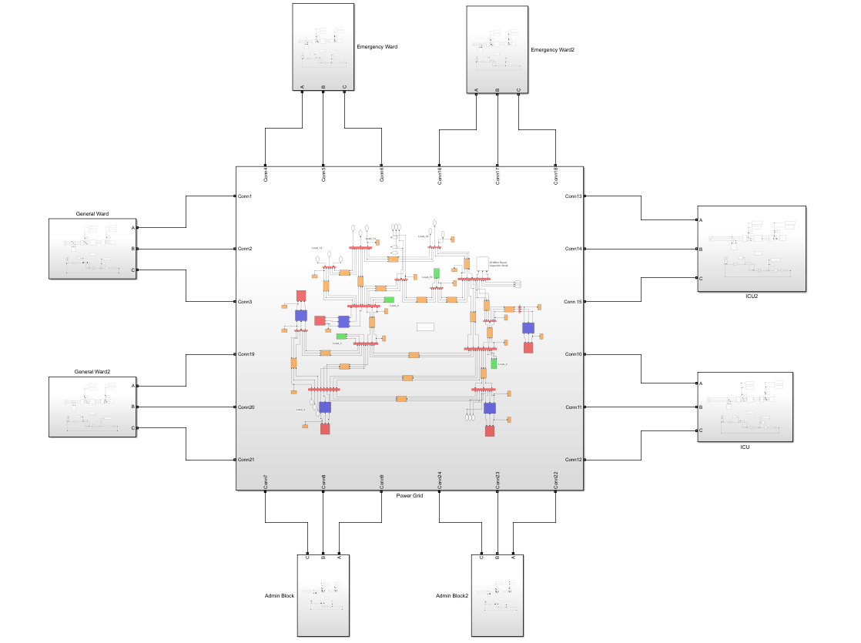
RESULTS - OVERALL
The Room models are integrated with the bus system successfully.
8 Rooms in total : 2 ICU
2 Emergency Ward
2 General Ward
2 Admin Block

Slide 10
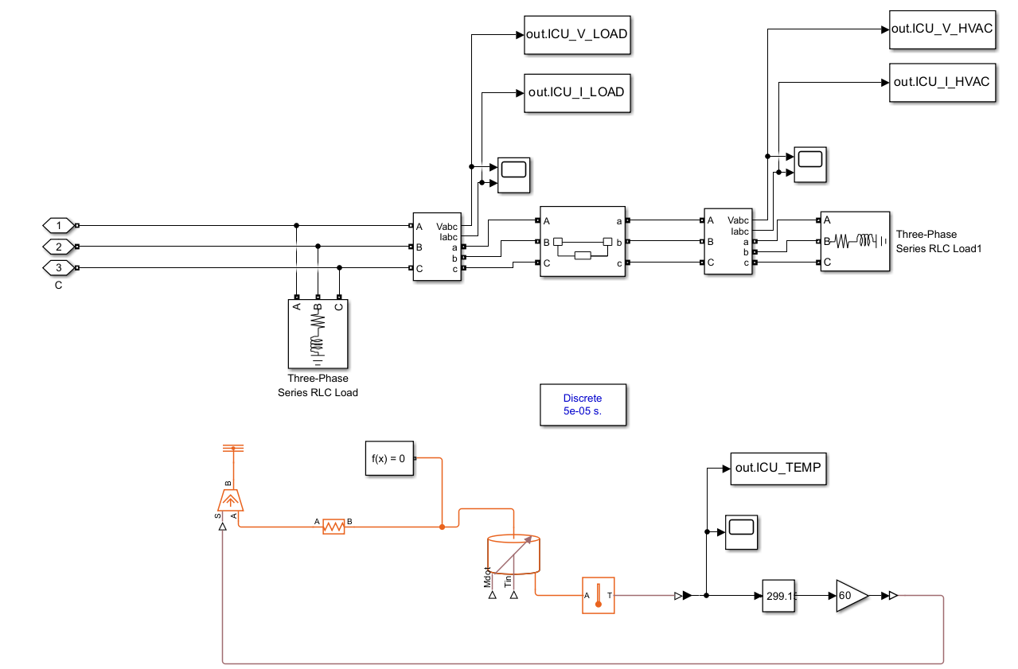
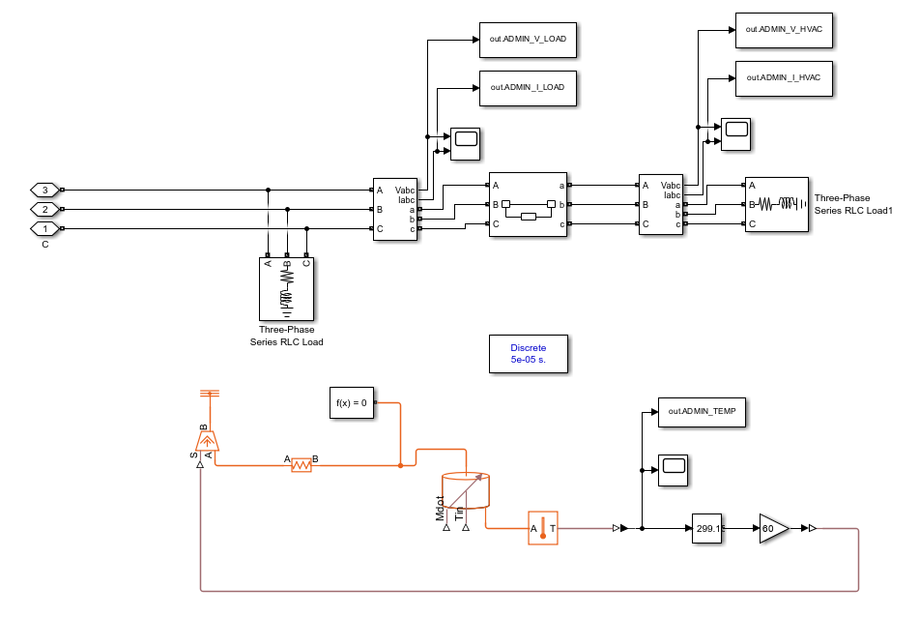
RESULTS - ROOMS
ICU ROOM ADMIN ROOM

Slide 11
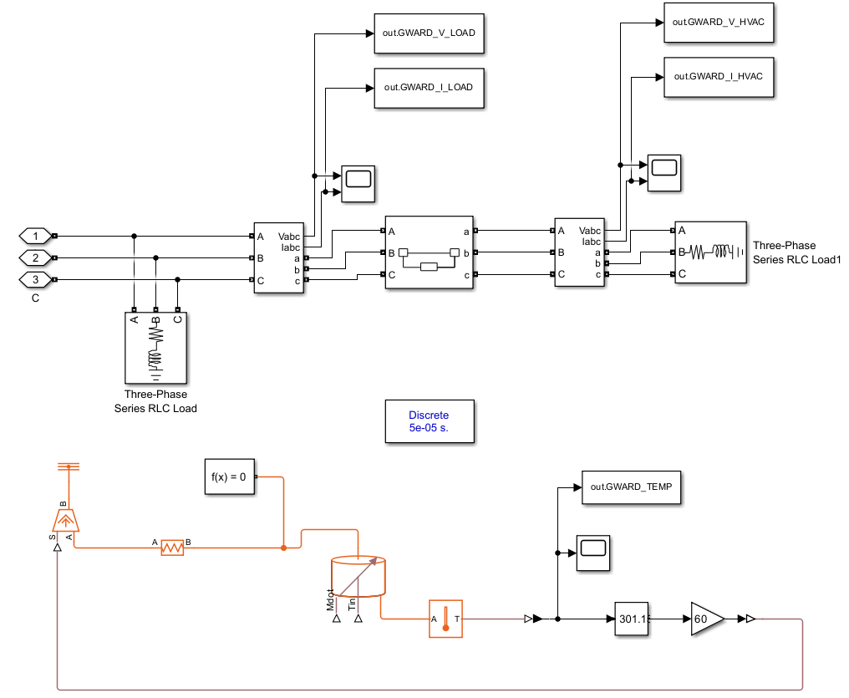
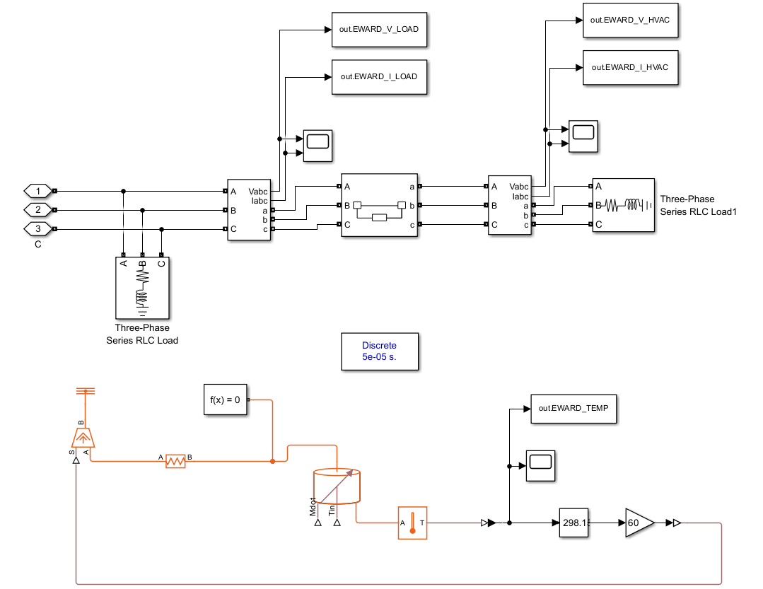
RESULTS - ROOMS
GENERAL WARD EMERGENCY WARD

Slide 12
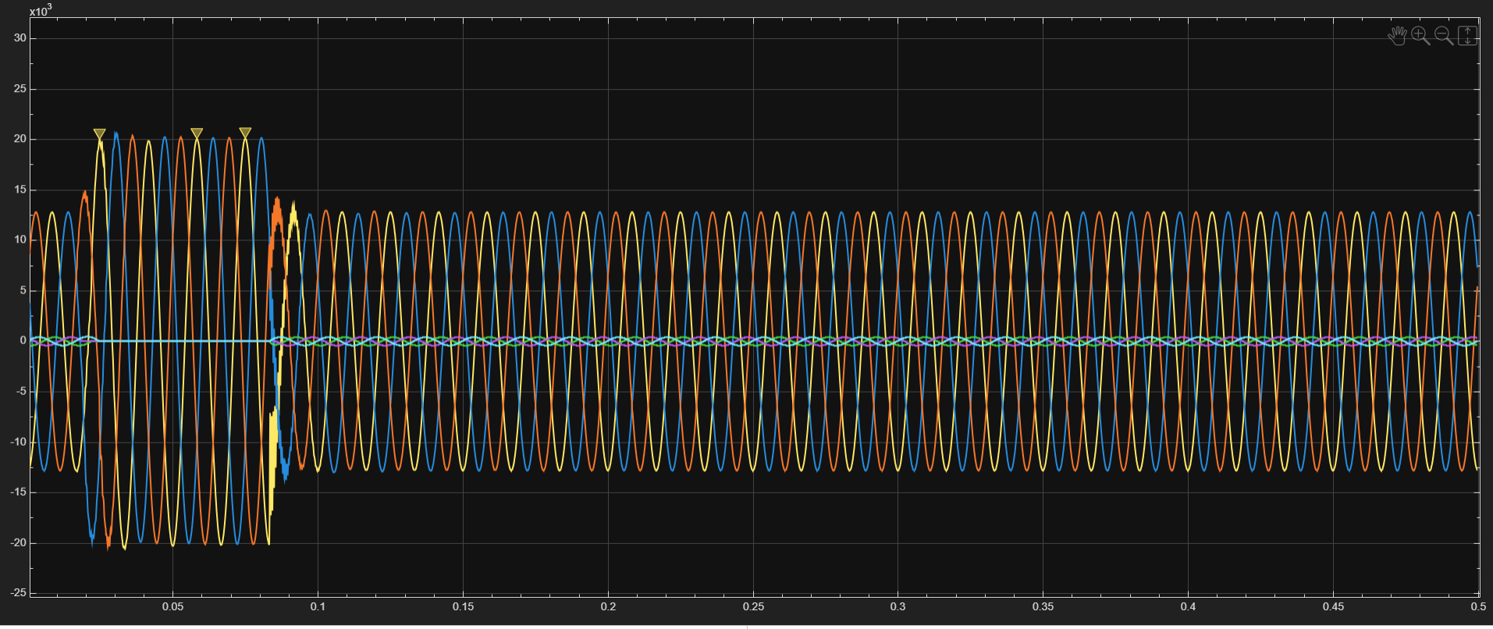
RESULTS - GRAPHS
Scope 1 (Electrical System) : V and I graph after general load

Slide 13
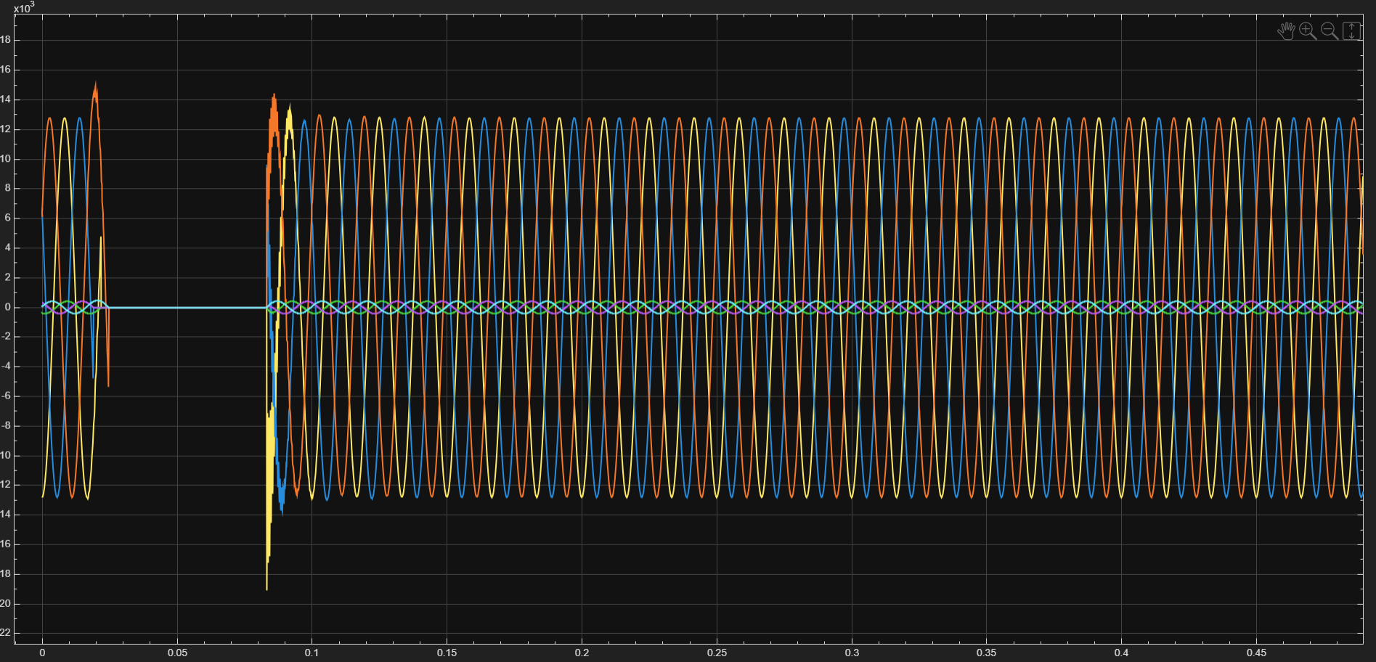
RESULTS - GRAPHS
Scope 2 (Electrical System) : V and I graph after HVAC load

Slide 14
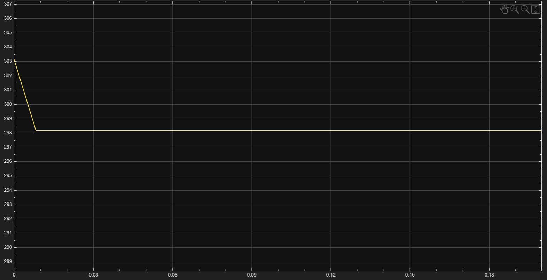
RESULTS - GRAPHS
Scope (Thermal system) – HVAC affecting the temperature

Slide 15
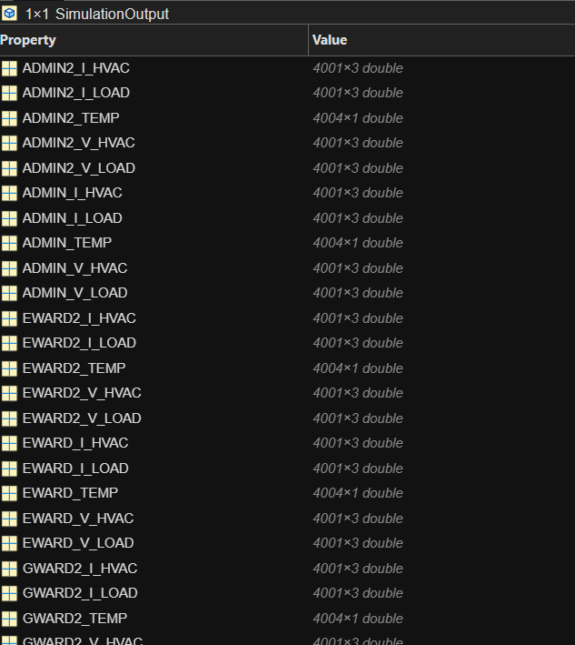
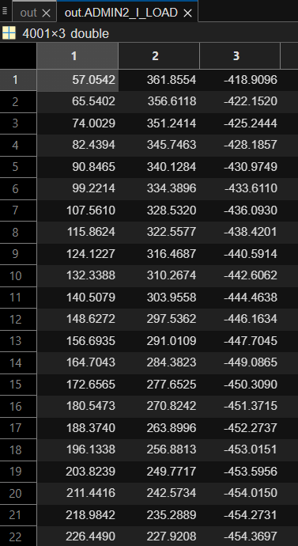
RESULTS – DATA AQUISITION
Data collected from every subsystem / Example data

Slide 16
HPC & AI for LB-MPC
GPU acceleration for training ML models inside LB-MPC
Use cuBLAS/cuDNN (via PyTorch/TensorFlow) for efficient matrix + deep learning ops
Reinforcement Learning integrated into LB-MPC for adaptive hospital energy control

Slide 17
Deploy VM (AWS EC2 / Azure VM / GCP Compute) with GPU/CPU support
Data pipeline:
Upload simulation & sensor data to cloud storage (S3 / Blob / GCS)
Stream real-time hospital zone data from EMS to the cloud
Forecasting module runs in the cloud for ambient temperature & load prediction
LB-MPC controller hosted on cloud VM for scalable decision-making
Cloud acts as central hub for data storage, forecasting, and control coordination

Slide 18
Cloud Workflow Architecture
Simulink / EMS generates zone-wise electrical & thermal data
Data uploaded to cloud storage (S3 / Blob)
Cloud compute (GPU VM) runs:
Forecasting models
LB-MPC optimization
Optimized control signals sent back to EMS for HVAC & load dispatch
Visualization dashboard for monitoring hospital zones in real-time

Slide 19
Cloud Components for App Deployment
For BDA + MATH PROJECT :
Compute (VM) → Runs GAN inference API + Kafka consumer.
Kafka Messaging → Streams image requests/events in real time.
Storage → Model weights, logs, processed results.
Networking → Public API endpoint + secure Kafka broker access.
Category | Technology
Distributed Storage | HDFS
Data Processing Framework | Apache Spark
Programming Language | Python /Scala
ML Framework | PyTorch
Frontend | React Native
Backend | Flask API
Visualization | Matplotlib / Seaborn
Real - Time analytics | Scala + Spark Structured Streaming + Kafka

Slide 20
Workflow
Train GAN locally → export model.pt.
Deploy model + API on cloud VM.
Kafka producer sends requests → consumer triggers inference.
API returns corrected image to client.
Cloud Usage in the Project
VM → Core inference environment.
Kafka → Stream-based communication between clients and inference system.
Networking → Secure endpoint for users and Kafka brokers.
Storage → For persistence of model, logs, and processed data.

Slide 21
References
H. Agharazi et al., "Installation and Testing of a Two-Level Model Predictive Control Building Energy Management System," in IEEE Transactions on Control Systems Technology, vol. 32, no. 2, pp. 326-339, March 2024
W. Cai, S. Sawant, D. Reinhardt, S. Rastegarpour and S. Gros, "A Learning-Based Model Predictive Control Strategy for Home Energy Management Systems," in IEEE Access, vol. 11, pp. 145264-145280, 2023
S. S. Tohidi, D. Calì and H. Madsen, "Adaptive Model Predictive Controller for Building Thermal Dynamics," in IEEE Control Systems Letters, vol. 8, pp. 1325-1330, 2024
B. He, N. Zhang, C. Fang, Y. Su and Y. Wang, "Flexible Building Energy Management With Neural ODEs-Based Model Predictive Control," in IEEE Transactions on Smart Grid, vol. 15, no. 5, pp. 4690-4704, Sept. 2024
H. Li, J. Xu and Q. Zhao, "Priority-Based Energy Allocation in Buildings Through Distributed Model Predictive Control," in IEEE Transactions on Automation Science and Engineering, vol. 22, pp. 7516-7529, 2025
B. K. Oleiwi and A. H. Sabry, "Controlling a House’s Air-Conditioning Using Nonlinear Model Predictive Control," in IEEE Embedded Systems Letters, vol. 16, no. 2, pp. 239-242, June 2024
G. Mantovani and L. Ferrarini, "Temperature Control of a Commercial Building With Model Predictive Control Techniques," in IEEE Transactions on Industrial Electronics, vol. 62, no. 4, pp. 2651-2660, April 2015
A. Martinčević and M. Vašak, "Constrained Kalman Filter for Identification of Semiphysical Building Thermal Models," in IEEE Transactions on Control Systems Technology, vol. 28, no. 6, pp. 2697-2704, Nov. 2020

